Slide 1
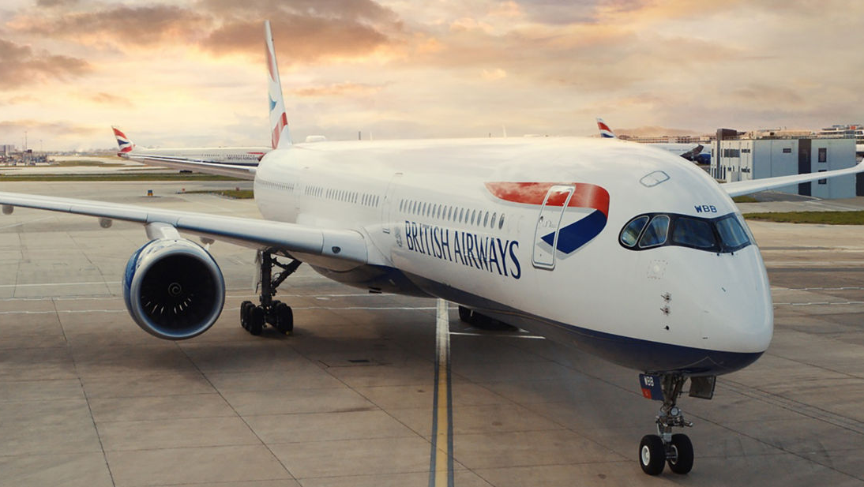
WHAT OUR CUSTOMERS SAY
Analysis of over 3000 reviews

Slide 2
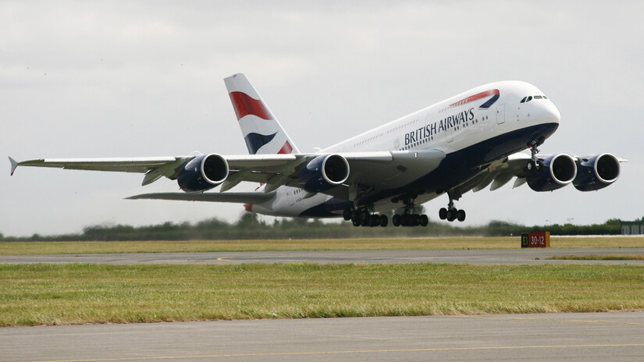
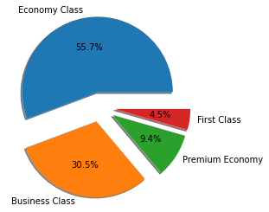
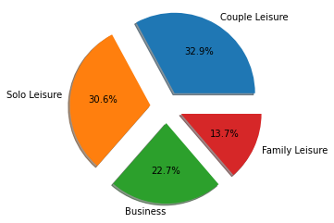
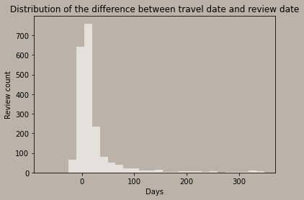


OUR CUSTOMERS
AVG ‘TURNAROUND’ TIME
h
THEIR THOUGHTS (1/2)

Slide 3
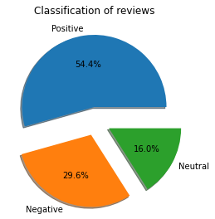

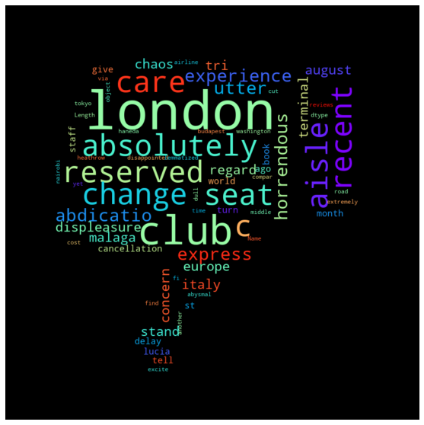
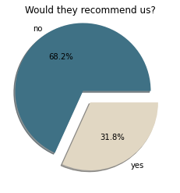

THEIR THOUGHTS (2/2)
h

